Slide 1
Faded Memories
Greenlight Presentation

Slide 2
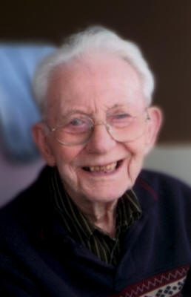
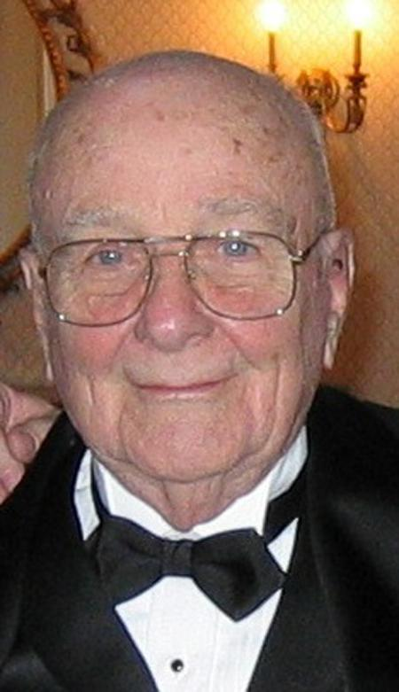
What is it?
A personal game where you walk through my grandfathers’ experiences and witness how Alzheimer’s affected them
Original Plan: 5 Memories + Epilogue & Intro
Now: Intro + 2 Memories

Slide 3
Themes
Personal Games
Empathy Games
Healing Through Creativity
Emotion
Memory (Postmemory)
Traumatic Experiences

Slide 4
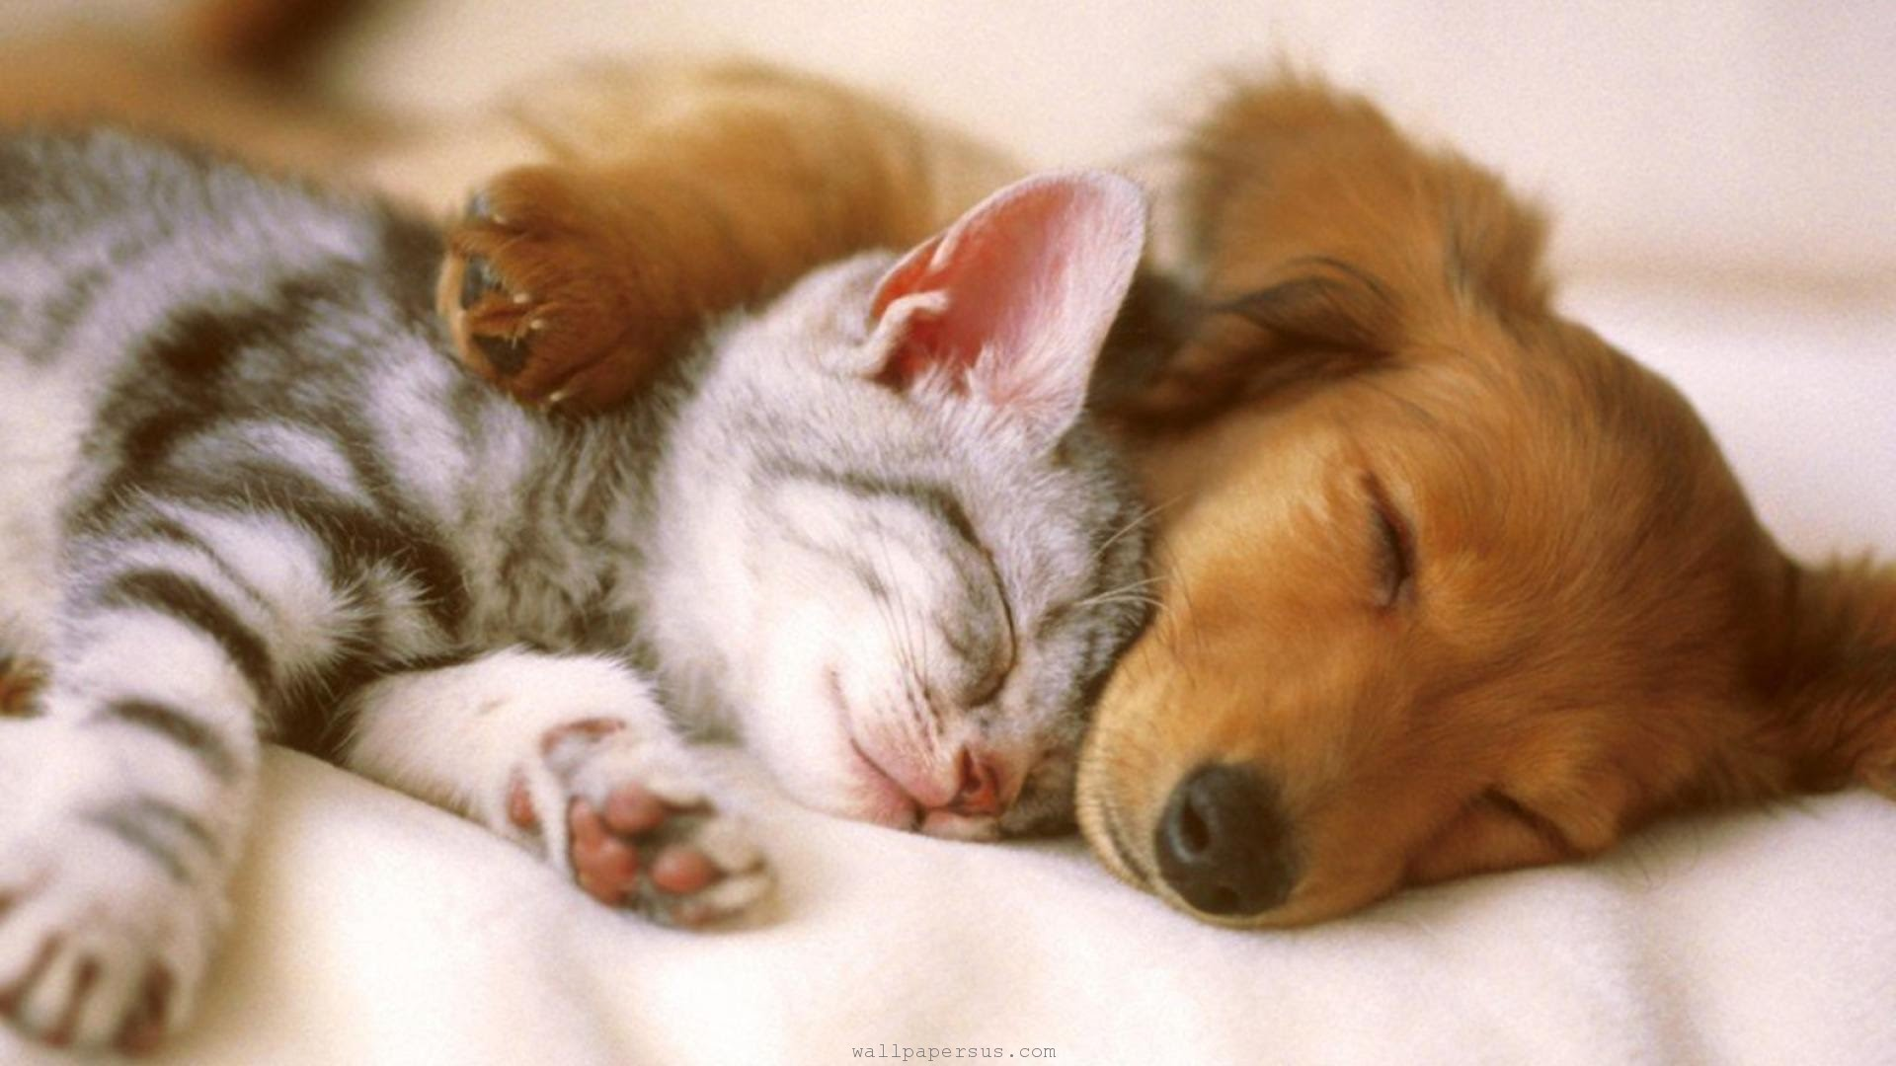
Why?
Explore the Process of Healing through Creativity
Impact of Personal Games on an External Audience

Slide 5
Research
Methodology: Iterative Design
Anna Anthropy
Doris Rusch
Game Design
Alzheimer’s Research
Coping Mechanisms

Slide 6
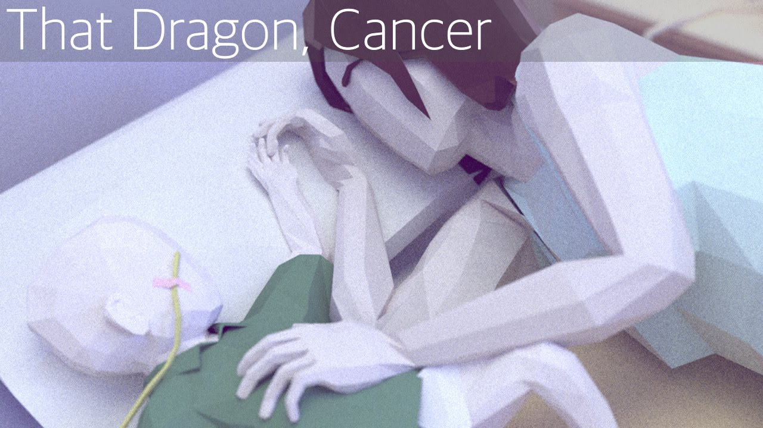

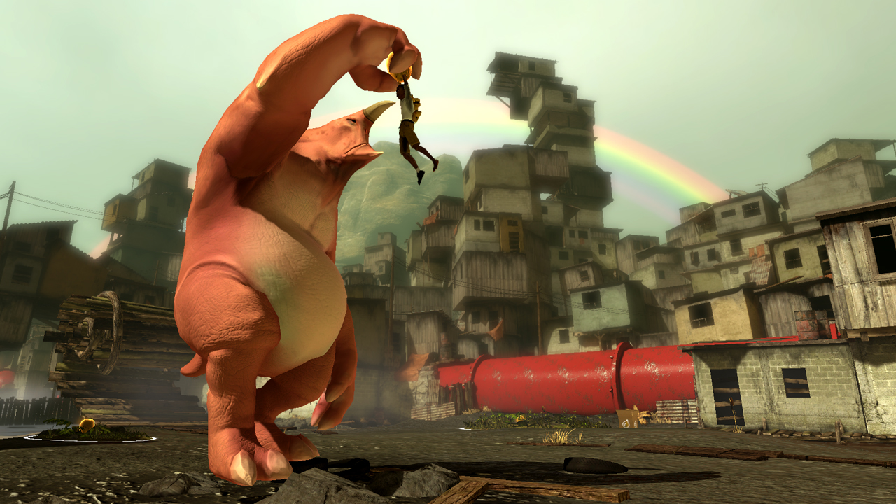
Related Projects
That Dragon, Cancer
Papa y Yo
Forget-Me-Knot
Maus
Gone Home
Dear Esther
Notes:
Forget-me-knot: Game made by Alexander Tarvet at Abertay University (Scotland)

Slide 7




requirements: Resources
Hardware:
Computer
Game Controller
OCAD Audio Studios
Software:
Unity
3DS Max
Photoshop
Audio Recording/Processing

Slide 8
requirements: Skills
Story Writing
3D Modelling/Animation
Texturing
Programming
Game Design
Project Management

Slide 9

Challenges
Emotional Engagement
User Testing
Own Personal Trauma

Slide 10

Opportunities
Help Others
Help Myself
Expanding Personal Games Genre

Slide 11
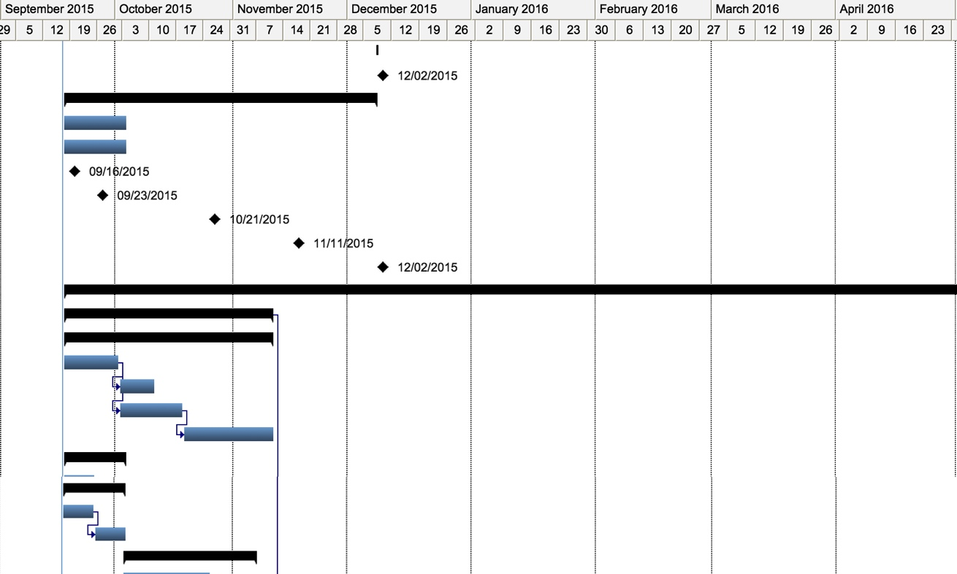
schedule

